Slide 1
Microsoft Fabric & DevOps enablement
Proposed agenda · three days
KPMG · Disney Tax Data Management & Innovation
DAY ONE
DAY TWO
DAY THREE
Foundations
Building in Fabric
Shipping to production
Shared vocabulary and the technical baseline.
Guided labs, from the build through to the business.
How changes ship, and the path to go-live.
01
02
03
04
05
06
Fabric Foundations
& Architecture
SQL, Python &
Data Concepts
Data Engineering
in Fabric
User Experience &
Consumption
DevOps, Governance
& Deployment
Taking Applications
to Production
Common ground for a room that mixes tax professionals with technologists.
The technical baseline, pitched for non-developers. Exercises throughout.
How workflows get built in the new environment. Hands-on.
How the tax organization and business reaches what gets built. Hands-on.
How changes get shipped once solutions are live. Labs continue.
The twelve steps from a working build to production, and who owns each.
Fabric at Disney
SQL fundamentals
Notebook development
Portal-driven execution
Git fundamentals
The Paved Path
The environment your team works in, and how it is set up
Querying concepts and basic data modelling
Notebooks as the primary build pattern, ETL and orchestration
Users enter inputs, notebooks run in the background
Source control and branching, assuming no prior experience
Infra setup to HCL handoff, and where it gets stuck
Migration strategy
Python fundamentals
Alteryx to notebooks
Reporting and Power BI
Deployment patterns
Who you need, and when
How the Alteryx estate moves across, with terms mapped back
Python basics and working with data in Fabric
How common Alteryx steps translate into notebook logic
Getting workflow output into Power BI and Power Query
Pipelines, environments, and promoting between workspaces
BAPPID, ESIS, consents, AI intake and email relay
Lakehouse and OneLake
Medallion architecture
Lab: migrate a workflow
Lab: add a front door
Lab: ship what you built
The long poles
Workspaces, tables, shortcuts and data organisation
Bronze, silver and gold layers, and what belongs at each
Guided migration of a prepared Alteryx workflow into Fabric
Give your lab workflow inputs, a trigger and an output
Put the lab workflow under source control and promote it
ESIS is five sequential reviews over four to eight weeks
UAT through to go-live
Acceptance in TEST, sign-off, then verifying the running app
Labs are structured and guided, built on representative Alteryx-to-Fabric migration scenarios in Disney's Fabric and Azure DevOps environments so no one gets blocked on a one-off workflow issue. Bring-your-own-workflow migration is handled in a separate Disney working session. Module 06 covers the existing TDMI delivery process, so the training reinforces the standard rather than introducing a second one. Attendees must be pre-credentialed before day one.
Delivered on-site at a Disney facility.

Slide 2
Microsoft Fabric & DevOps enablement
Proposed agenda · two days, extending to three if needed
KPMG · Disney Tax Data Management & Innovation
Scoped as two days. This can extend into a third day as the material comes together — we would rather add time than rush the concepts.
DAY ONE
DAY TWO
Foundations
Building, shipping and consuming
Shared vocabulary, then the SQL and Python baseline the team will build on.
Hands-on workflow development, the AI-assisted way of working, and how solutions reach production and the people who use them.
01
02
03
04
05
Fabric Foundations
& Architecture
SQL, Python &
Data Engineering
Hands-On Labs &
Workflow Development
DevOps, Governance, VS Code & Git
Deployment & Production Readiness
Common ground for a room that mixes tax professionals with technologists.
The baseline skillset, pitched for a non-developer audience. Exercises throughout.
The bridge between Fabric and application development, through to what the business sees.
How AI is used to create and accelerate Fabric development work.
Awareness of the lifecycle rather than operational ownership for every attendee.
What Fabric looks like at Disney
SQL fundamentals
Notebook-centric development
AI-generated Python and SQL
Git and source control
The environment your team works in, and how it is set up
Querying concepts and basic data modelling, with practical exercises
Notebooks as the primary build pattern, ETL and orchestration
Practical prompting, and agent-assisted app development
Branching, promotion, and why source control matters
Alteryx migration strategy
Python fundamentals
Lab: migrate a real workflow
Release and environments
The promotion process
How the workflow estate moves across, with terms mapped back to Alteryx
Python basics and working with data in common Fabric scenarios
Take one of your Alteryx workflows through to a working Fabric build
Dev, test and production, and the paved road for shipping changes
The lifecycle end to end, the approval gates and realistic timelines
Lakehouse and OneLake
Medallion architecture
Portal-driven execution
VS Code as the workbench
Working with Enterprise Tech
Workspaces, tables and shortcuts, and how data is organised
Bronze, silver and gold layers, and what belongs at each stage
Users supply inputs and parameters, notebooks run in the background
Lakehouse connection, notebook development, deployment and Git
Who you need, when to start, and what each approval actually asks for
Power BI, Power Query and Excel
Connecting to Fabric, semantic models, consumption patterns
Hands-on work runs inside Disney's Fabric POC environment, using the team's own workflows rather than sample data. All attendees are provisioned in advance. Power BI, Power Query and Excel integration sits inside Module 3, alongside the workflows the reporting draws from. Module 5 is scoped to awareness, not operational ownership. Disney governance, operating model and Fabric management decisions are handled in a separate internal session.
Delivered on-site at a Disney facility. · Venue to be confirmed.
KPMG

Slide 3
Microsoft Fabric & DevOps enablement
Proposed agenda · October 19–20
KPMG · Disney Tax Data Management & Innovation
DAY ONE · MONDAY 19 OCTOBER
DAY TWO · TUESDAY 20 OCTOBER
Full day
Full day
Hands-on in Fabric. Shared vocabulary, then building and reaching real workflows.
Deployment, and the process and people between a build and production.
01
02
03
04
05
Fabric Foundations
& Architecture
Data Engineering
in Fabric
User Experience &
Workflow Consumption
DevOps, Governance
& Deployment
Taking Applications to Production
Common ground for a room that mixes tax professionals with technologists.
How workflows get built in the new environment. Hands-on.
How the wider tax organization and business reaches what gets built. Hands-on.
How changes get shipped once solutions are live. Labs continue here.
The twelve steps from a working build to production, and who owns each one.
What Fabric looks like at Disney
Lakehouse concepts
Portal-driven workflow execution
Git fundamentals
The Paved Path
The environment your team actually works in, and how it is set up
OneLake, workspaces, tables and shortcuts, and how data is organised
Users supply inputs and parameters, notebooks run in the background
Source control basics and branching, assuming no prior experience
Infra setup through to HCL handoff, and where each step gets stuck
Alteryx migration strategy
Medallion architecture
Reporting integration
Deployment patterns
Who you need, and when
How the workflow estate moves across, with Fabric terms mapped back to Alteryx
Bronze, silver and gold layers, and what belongs at each stage
The end-to-end path from workflow output through to a finished report
Deployment pipelines and promoting work between workspaces
The teams behind BAPPID, ESIS, consents, AI intake and email relay
Technical foundations
Notebook-centric development
Power BI and Power Query
Release and environments
The long poles
Database, SQL and Python concepts pitched for a non-developer audience
Notebooks as the primary build pattern, ETL development and orchestration
Getting Fabric data into the reports the tax organization already uses
Dev, test and production, and the paved road for shipping changes
ESIS is five sequential reviews over four to eight weeks. Start it week one
Lab: build a workflow
Lab: put a front door on it
Lab: ship what you built
UAT through to go-live
Take one of your own Alteryx workflows through to a working Fabric build
Give the workflow you built inputs, a trigger and somewhere the output lands
Put day one's workflow under source control and promote it upward
Acceptance in TEST, functional sign-off, then verifying the running app
Hands-on work runs inside Disney's Fabric and Azure DevOps environments, using the team's own workflows rather than sample data. Pillar 05 covers the existing TDMI delivery process, so the training reinforces the standard rather than introducing a second one. Attendees must be pre-credentialed before the 19th.
Delivered on-site at a Disney facility.

Slide 4
Now you've built it. Ship it.
The twelve steps between a working build and production
KPMG · Disney Tax Data Management & Innovation
1
2
3
4
5
6
Infra setup (ADO)
UI draft created
UI review w/ business
Dev build
Test build
AI engine build
Repo and pipelines stood up on the standard stack
A first working interface, built to react to rather than describe
The people who will use it confirm the shape before the build hardens
First deploy to DEV. Proof is the running app answering a request
Promoted through pipelines into the shared TEST environment
The AI layer built and grounded against real Fabric data
7
8
9
10
11
12
Full flow confirmed
UAT (test env)
Functional sign-off
ESIS approved
Moved to production
Docs for HCL handoff
End to end, with every state reachable, not just the happy path
Business users run the manual cycle. Needs TEST consent first
The process owner signs. This gates the production build
Five sequential reviews. The long pole — start it in week one
Same tag, explicit confirmation, every governing approval closed
The support handover. Written along the way, not at the end
Steps 1 to 9 run on your clock. Steps 10 and 12 do not — those are the ones that decide your date.

Slide 5
Who you need, and when
The approvals track, and why it starts in week one
KPMG · Disney Tax Data Management & Innovation
Enterprise Technology
Approvals & consents
Create BAPPID
ServiceNow CMDB record, with a named technical owner
Week one
Raise ESIS (RITM)
Permissions list, PII and data classification
Week one
TEST admin consent
Delegated scopes. Gates UAT — nothing can be tested without it
Before UAT
ESIS approval
Service Mgmt → Engineering → Security → Legal → Operations
4–8 weeks
PROD admin consent
Constrained app permissions on the production tenant
Before go-live
Email relay onboarding
ET&D Messaging. Required before go-live, not after
Before go-live
Technology Enablement
AI governance
AI intake form
Required for any AI use case, submitted through the intake portal
Week one
The business
Testing & sign-off
UAT testing
Your users, running the manual cycle in the TEST environment
After TEST consent
Functional sign-off
The process owner signs. This is what gates the production build
Before go-live
An approval nobody opened is still open at go-live. Nothing about it being forgotten makes it optional.
Named owners for each of these are to be confirmed with TDMI before the session, so attendees leave with contacts rather than team names.

Slide 6
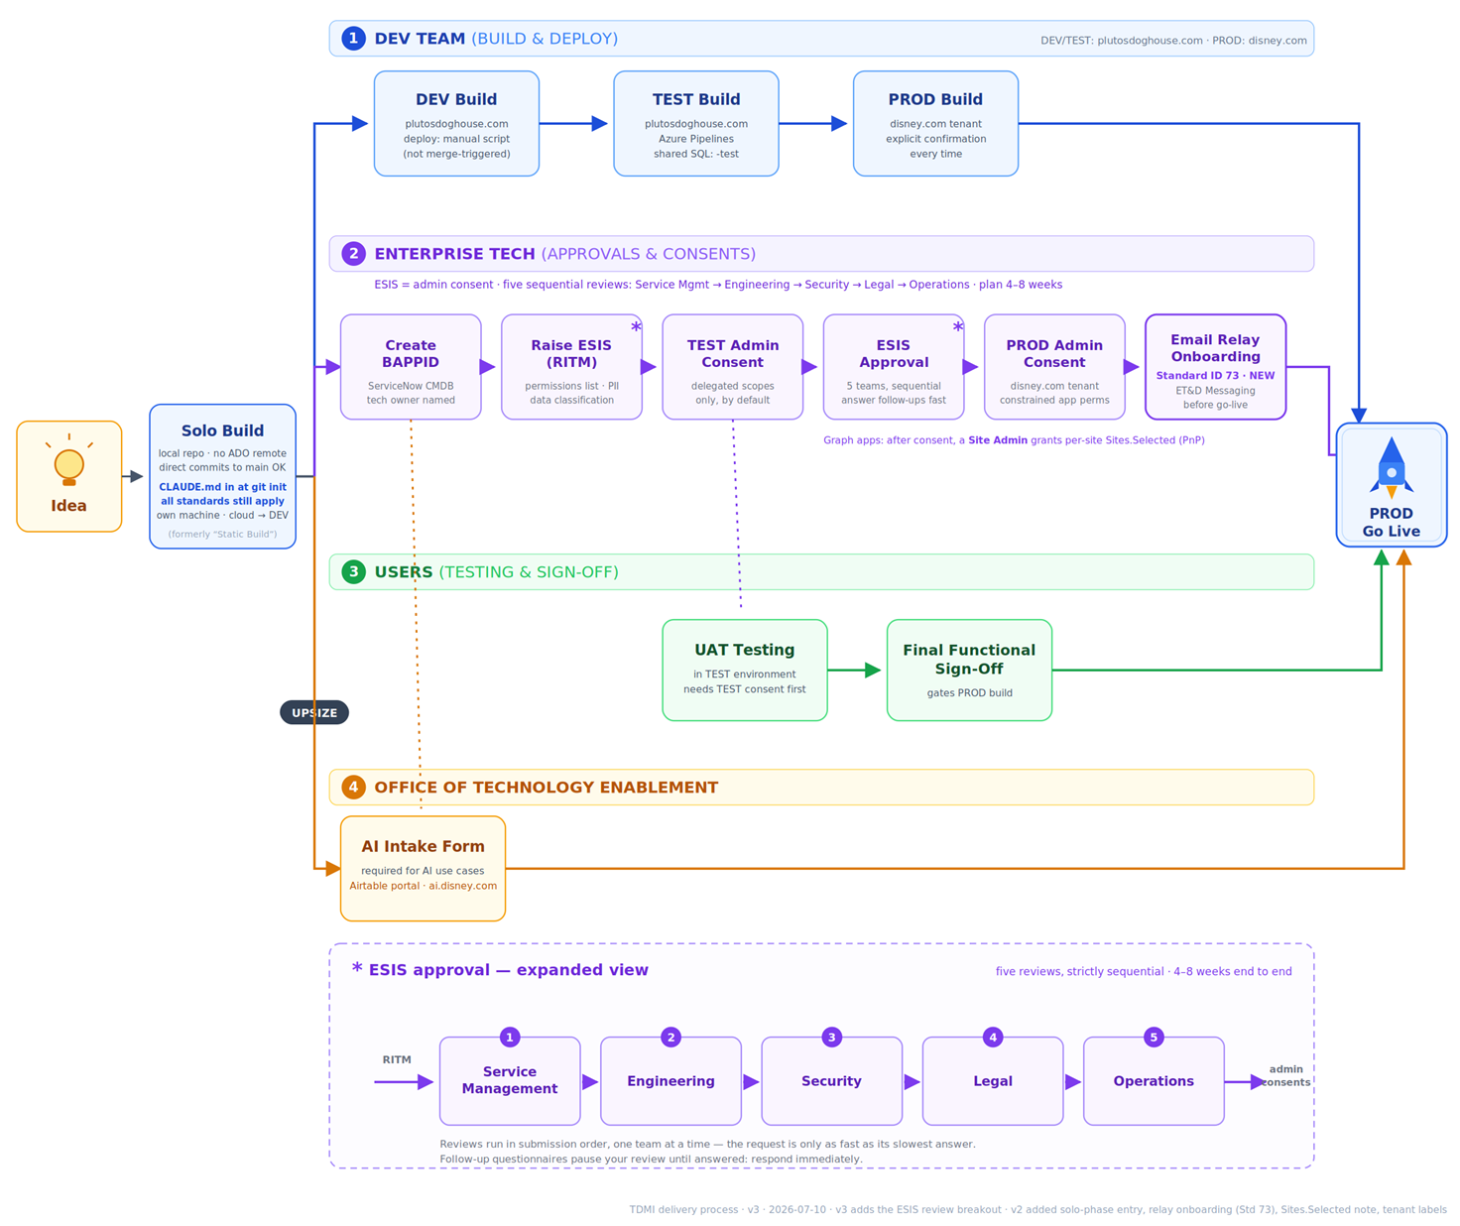

Slide 7
Microsoft Fabric & DevOps enablement -- Proposed agenda · October 19–20
DAY ONE · MONDAY 19 OCTOBER
DAY TWO · TUESDAY 20 OCTOBER
Half day, afternoon
Full day
Shared vocabulary first, then how workflows get built.
How the organization reaches what gets built, how changes ship, and how solutions get built with Claude.
01
02
03
04
05
Fabric Foundations
& Architecture
Data Engineering
in Fabric
User Experience &
Workflow Consumption
DevOps, Governance
& Deployment
Claude-Enabled
Application Development
Common ground for a room that mixes tax professionals with technologists.
How workflows get built in the new environment.
How the wider tax organization & business reaches what gets built.
How changes get shipped once solutions are live.
How solutions get built with Claude, and what it takes to support them afterwards.
Why Disney is moving to Fabric
Lakehouse concepts
Portal-driven workflow execution
Git fundamentals
Building with Claude Code
Current state, the business case and the target operating model
OneLake, workspaces, tables and shortcuts, and how data is organised
Users supply inputs and parameters, notebooks run in the background
Source control basics and branching, assuming no prior experience
Working against Fabric data, and the path from a first prototype to production
Alteryx migration strategy
Medallion architecture
Reporting integration
Deployment patterns
Sustaining what gets built
How the workflow estate moves across, with Fabric terms mapped back to Alteryx
Bronze, silver and gold layers, and what belongs at each stage
The end-to-end path from workflow output through to a finished report
Deployment pipelines and promoting work between workspaces
The standards and release process that keep an application supportable
Technical foundations
Notebook-centric development
Power BI and Power Query
Release and environment strategy
AI and agent integration
Database, SQL and Python concepts pitched for a non-developer audience
Notebooks as the primary build pattern, ETL development and orchestration
Getting Fabric data into the reports the tax organization already uses
Dev, test and production, and the paved road for shipping changes
Fabric Data Agents, Copilot and where the AI layer sits on top of Fabric
Hands-on work runs inside Disney's Fabric environment across pillars 2, 4 and 5, and anchors to existing Microsoft Learn material. Platform security and governance sits with Disney enterprise technology. Pillar 5 is scoped to building on top of Fabric workloads and the process around it, not full-stack Azure development.
Delivered on-site at a Disney facility.
Presented to Jason / Shanna on 9.17. Feedback- more time on claude enabled app development.

Slide 8
Microsoft Fabric & DevOps enablement
Proposed agenda · October 19–20
KPMG · Disney Tax Data Management & Innovation
DAY ONE · MONDAY 19 OCTOBER
DAY TWO · TUESDAY 20 OCTOBER
Half day, afternoon
Full day
Three pillars, each building on the one before it — how solutions are built, how the wider organization reaches them, and how changes are shipped.
01
02
03
04
Fabric Foundations & Architecture
Data Engineering in Fabric
User Experience & Workflow Consumption
DevOps, Governance & Deployment
The afternoon sets the shared vocabulary for the room before any Fabric-specific material. Pitched for a mixed audience of tax professionals and technologists.
How workflows are actually built in the new environment.
How the wider tax organization reaches what gets built.
How changes are shipped safely once solutions are live.
Why Disney is moving to Fabric
Lakehouse concepts
Portal-driven workflow execution
Git fundamentals
Current state, the business case and the target operating model
OneLake, workspaces, tables and shortcuts, and how data is organised
Users supply inputs and parameters, notebooks run in the background
Source control basics and branching, assuming no prior experience
Alteryx migration strategy
Medallion architecture
Reporting integration
Deployment patterns
How the workflow estate moves across, with Fabric terms mapped back to Alteryx
Bronze, silver and gold layers, and what belongs at each stage
The end-to-end path from workflow output through to a finished report
Deployment pipelines and promoting work between workspaces
Technical foundations
Notebook-centric development
Power BI and Power Query
Release and environment strategy
Database, SQL and Python concepts pitched for a non-developer audience
Notebooks as the primary build pattern, ETL development and orchestration
Getting Fabric data into the reports the tax organization already uses
Dev, test and production, and the paved road for shipping changes
Deprecated from max’s comment
Hands-on work runs inside Disney's Fabric environment across pillars 2 and 4 and anchors to existing Microsoft Learn material. Platform security and governance sits with Disney enterprise technology. Application development is scoped to lightweight interfaces over Fabric workloads rather than full-stack Azure build.
Delivered on-site at a Disney facility.
KPMG
© 2026 KPMG LLP, a Delaware limited liability partnership and its subsidiaries are part of the KPMG global organization of independent member firms affiliated with KPMG International Limited, a private English company limited by guarantee. All rights reserved.
1

Slide 9
Microsoft Fabric & DevOps enablement
Proposed agenda · October 19–20
KPMG · Disney Tax Data Management & Innovation. Where the agenda stands today, and the items still open ahead of Friday’s group call.
Proposed shape of the session
DAY ONE · MONDAY, OCTOBER 19
DAY TWO · TUESDAY, OCTOBER 20
Half day, afternoon
Full day
Opens with a short framing session and moves straight into a working discussion on how TDMI implements Fabric going forward. Hosted at a Disney facility.
Data engineering patterns, the hands-on lab, deployment and the application and AI layers. Expecting fewer than ten attendees.
Proposed agenda
Open items
1
Framing and target state
DAY 1
Defining application development
A short opener — where Fabric fits at Disney and what the two days are for
1
2
Core Fabric capabilities and principles
DAY 1
Johnny’s framing is lightweight interfaces over Fabric workloads rather than full-stack build. We want your read before we lock the module.
OneLake, workspaces, Lakehouse, Warehouse, Direct Lake — kept tight, no entry-level material
3
What Fabric at Disney looks like
WORKING
2
What the Fabric working session covers
A working session to build consensus across TDMI on how you implement Fabric going forward
The topics TDMI needs to reach consensus on. This is the part that cannot come from Microsoft Learn.
4
Data engineering patterns
DAY 2
Medallion architecture and transformation patterns, framed conceptually
3
Alteryx workflow inventory
5
Hands-on lab
HANDS-ON
Does a current list exist? Sizing the candidates high, medium and low would shape how we frame the migration content.
A single focused lab: transformation through Dataflow Gen2, then CI/CD through Azure DevOps
6
Deployment and release
DAY 2
4
Environment access as a hard prerequisite
Git, branching, Dev / Test / Prod and the paved road for shipping changes
All attendees pre-credentialed and the workspace provisioned in advance. No setup time on the day.
7
User-facing experiences on Fabric
DAY 2
The spectrum: capturing inputs, triggering pipelines, monitoring runs and returning results
5
Confirming the day and a half
8
AI and agent integration
DAY 2
Half day on the 19th, overnight, full day on the 20th — confirming this matches what your team expects.
Fabric Data Agents, Copilot and how the AI layer sits on top of Fabric
What Jack presented to Alex on 9/16
Fabric security and governance sits with Disney enterprise technology, so it is not covered here. Hands-on work anchors to existing Microsoft Learn material rather than custom labs.
Friday’s group call is where we take this to a first-draft agenda with the wider TDMI team.
© 2026 KPMG LLP, a Delaware limited liability partnership and its subsidiaries are part of the KPMG global organization of independent
member firms affiliated with KPMG International Limited, a private English company limited by guarantee. All rights reserved.
1

Slide 10
Fabric & DevOps enablement
Internal working session
Internal only. Aligning on a one-day agenda and resolving open questions ahead of Friday’s call with Disney.
KPMG internal Call on 9/14
Key dates
FRIDAY · 2:30 EST
MONDAY · OCTOBER 19
Full group call with Disney
Training delivered at Disney
Introductions and a walk-through of the proposed agenda. This is the session where we validate scope with Garret, Alex, Mike and Johnny together.
Venue has moved — no longer Lakehouse. Disney will host now.
New proposed one-day agenda
Still unclear — needs discussion
1
Kickoff and target state
RECAP
Define application development
Alteryx to Fabric to a user-facing output, end to end
1
2
Fabric foundation
Johnny’s view is lightweight interfaces over Fabric workloads, not React or full-stack. Friday is where we understand that with Garret, Alex and Mike.
OneLake, workspaces, Lakehouse, Warehouse, Direct Lake
RECAP
The underlying business problem
Data engineering
2
3
Pipelines, notebooks, shortcuts, medallion — mapped to Alteryx patterns
NET-NEW
Business users should launch their own workflows so Tax team is no longer the middleman.
4
Alteryx to Fabric migration patterns
NET-NEW
3
One KPMG point of view on front-end
Decomposing a real workflow: pipeline, notebook or parameter
Whether Fabric offers native capability. Settle internally before Friday.
5
User-facing experiences on Fabric
NET-NEW
4
How hard to push the current paved road (Process Cannon)
The spectrum: input capture, triggering pipelines, monitoring, returning results
Johnny’s repository standards as the target state or as the baseline for the wider team.
6
DevOps and deployment
NET-NEW
One day or two
Git, branching, CI/CD, Dev / Test / Prod, monitoring, the Process Canon model
5
7
AI and agent integration
NET-NEW
The proposal to Jason was two days. This agenda is built as one — confirm before Friday.
Fabric Data Agents, Copilot, Claude-based development standards, grounding
6
Gating items for the hands-on work
8
Hands on lab
HANDS-ON
Workflow selection and environment access to Fabric and Azure DevOps. The deadline is now 19 October.
Their workflow: source to Fabric to a triggered run, shipped through a pipeline
Internal working draft — not for distribution to Disney.
© 2026 KPMG LLP, a Delaware limited liability partnership and its subsidiaries are part of the KPMG global organization of independent
member firms affiliated with KPMG International Limited, a private English company limited by guarantee. All rights reserved.
1

Slide 11











KPMG
What KPMG presented to Jason initially on 8/26
PROPOSED AGENDA · INTERNAL DRAFT
Disney Tax Technology - Microsoft Fabric & Application Development Enablement
Full-day, on-site (~6.5 hrs content + lunch; scalable to half-day)
1
30 min
2
45 min
3
60 min
4
45 min
Kickoff & Architecture
Fabric Foundation
Data Engineering
Security & Governance
What Fabric is, where it fits at Disney; target Alteryx→Fabric pattern; coexistence with Snowflake / Databricks
OneLake, workspaces, Lakehouse, Warehouse, Direct Lake
Pipelines, notebooks, shortcuts, Bronze / Silver / Gold — mapped to Alteryx patterns they know
Entra, workspace roles, OneLake security, Purview, RLS / OLS
RECAP
RECAP
NET-NEW
NET-NEW
5
60 min
6
45 min
7
45 min
8
75 min
Application Development
AI & Agent Integration
DevOps & Deployment
End-to-End Lab
Talk through the KPMG + Johnny (TDMI) work: idea→PROD process, Solo→Upsize, React / FastAPI / Azure SQL apps on Fabric
Talk through the KPMG + Johnny (TDMI) work: Foundry, Copilot, Fabric Data Agents, grounding in Fabric
Git, CI/CD, Dev / Test / Prod, deployment pipelines, monitoring
Build a small solution: source → Fabric → app, in Disney's environment
NET-NEW
NET-NEW
NET-NEW
HANDS-ON
LUNCH (45 min)
WRAP-UP (15 min) — checklist · pitfalls · next steps

